Slide 1




NEXT GEN EMPLOYABILITY PROGRAM
Creating a future-ready workforce
Team Members
College Name
Student Name :Harish prabu S
Student ID :au110321104014
GRT IET

Slide 2
NEXT GEN EMPLOYABILITY PROGRAM
Creating a future-ready workforce
Team Members
College Name
Student Name :Harish prabu .S
Student ID :au110321104014
Student Email ID : harishprabu2003@gmail.com
1103-GRT institute of engineering and technology

Slide 3
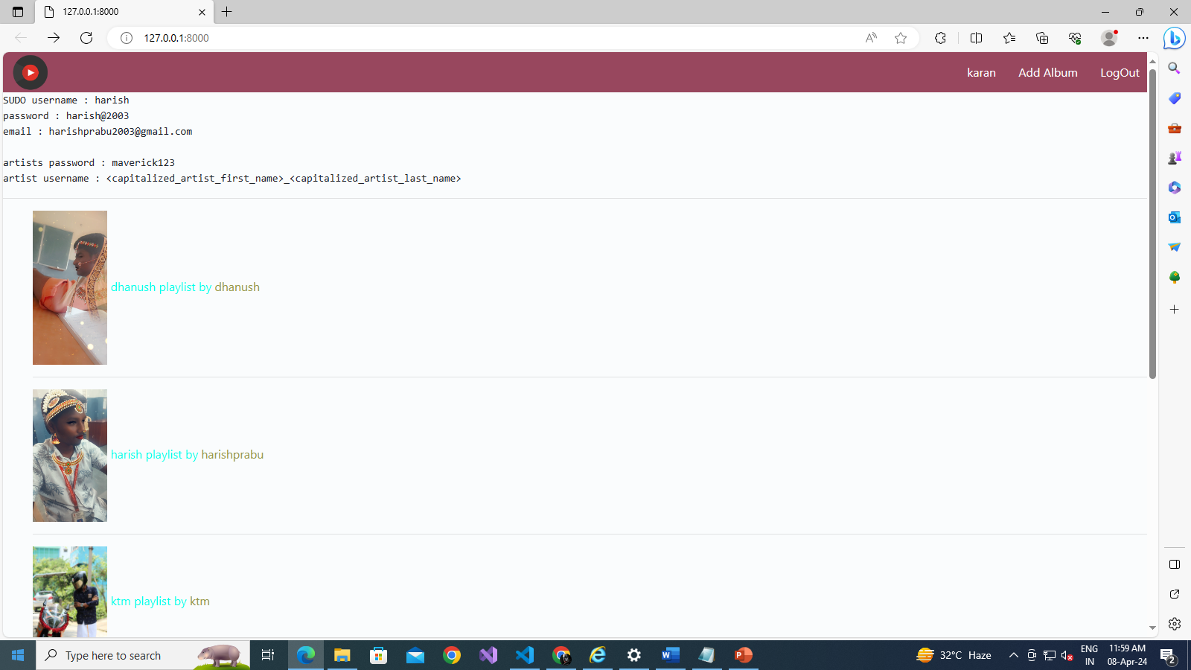

Slide 4
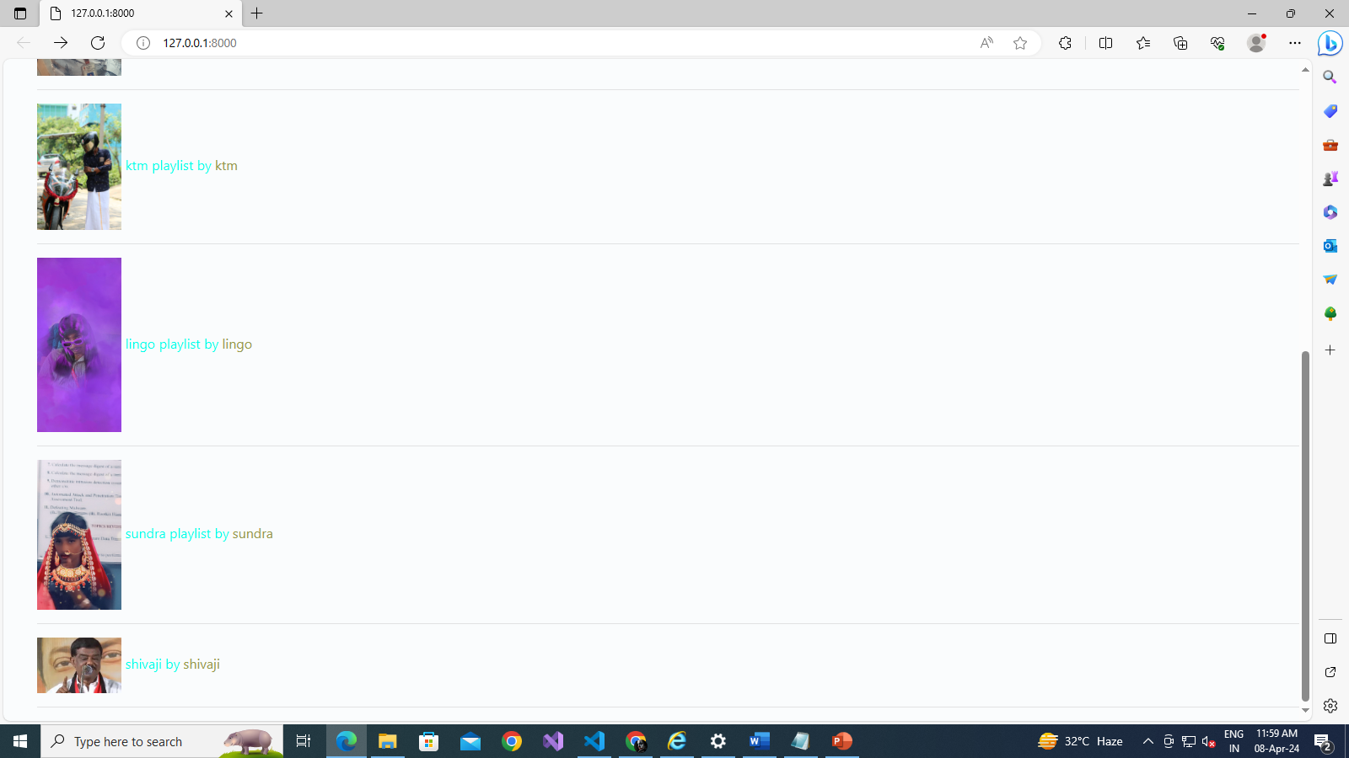

Slide 5
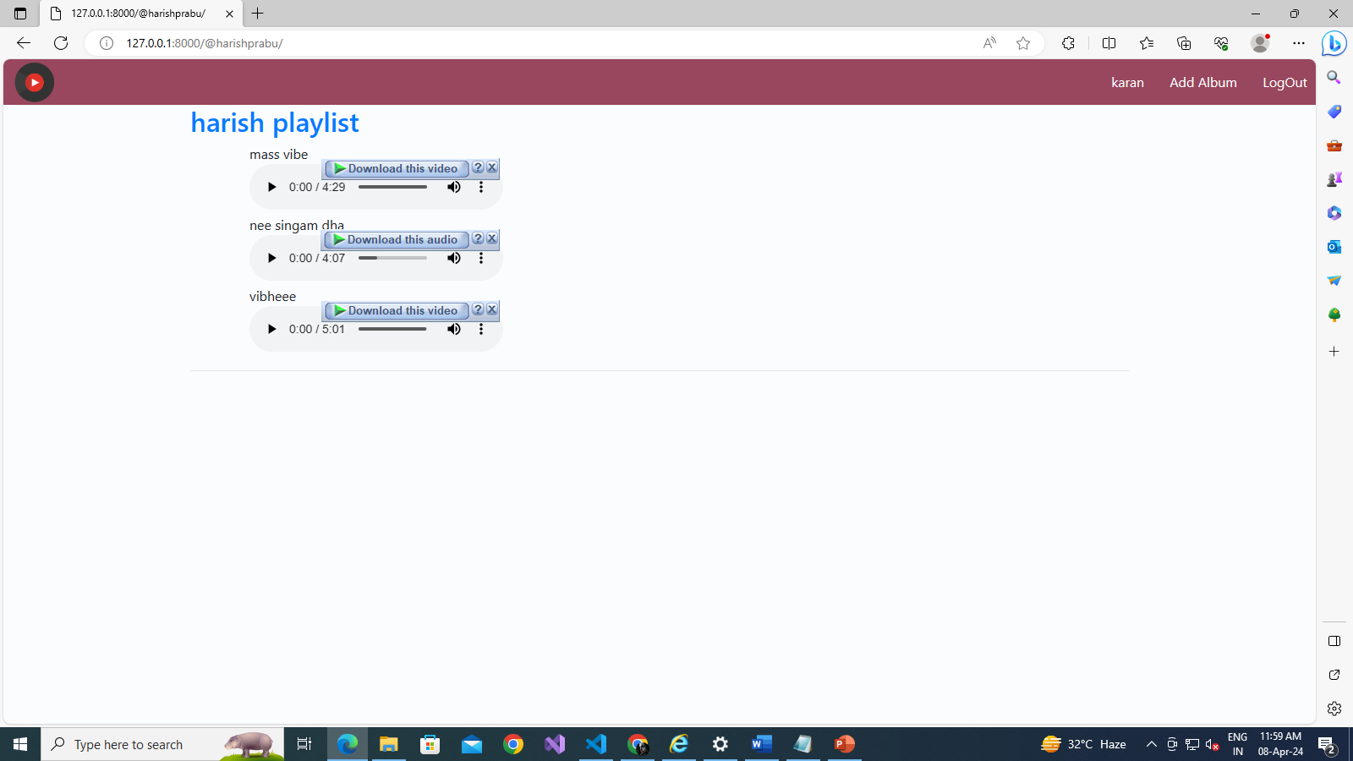

Slide 6
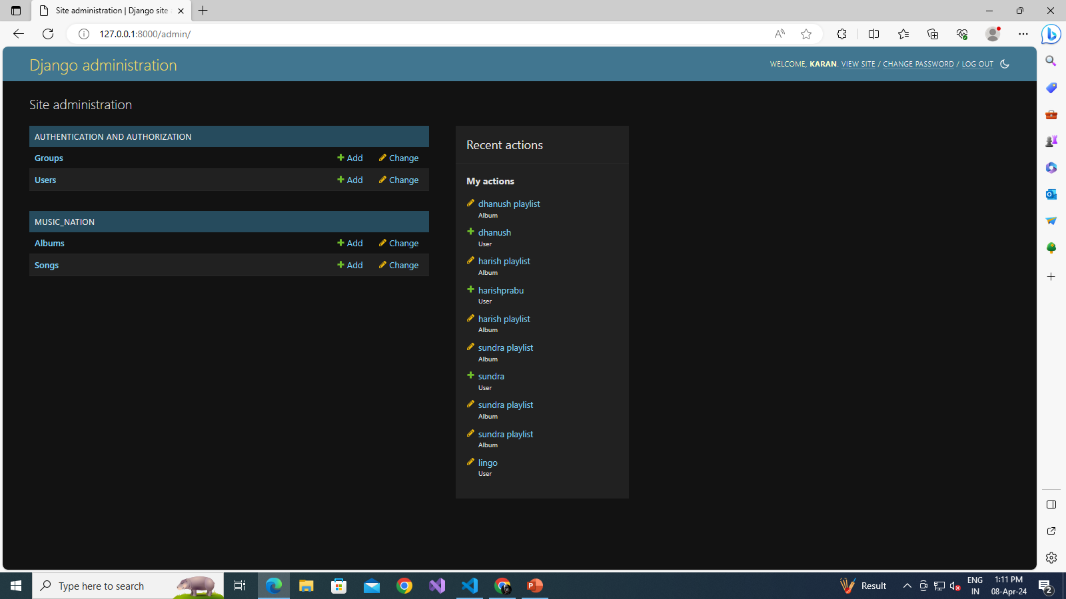

Slide 7


Slide 8
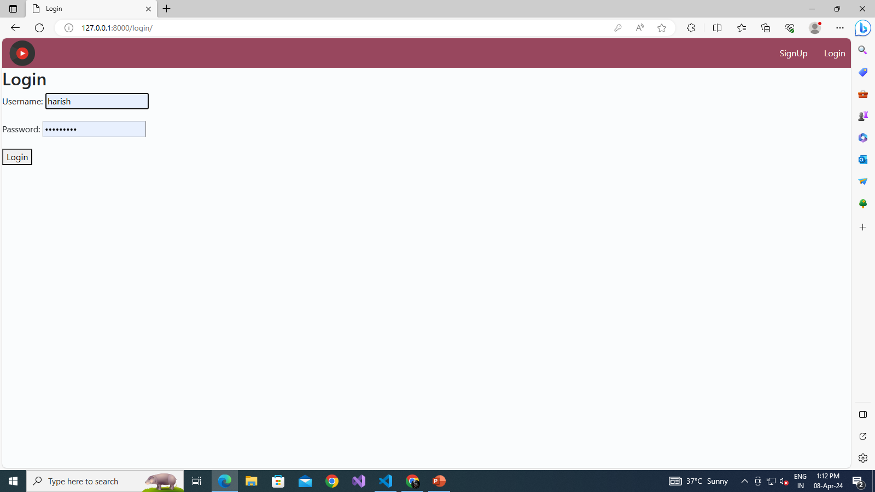

Slide 9
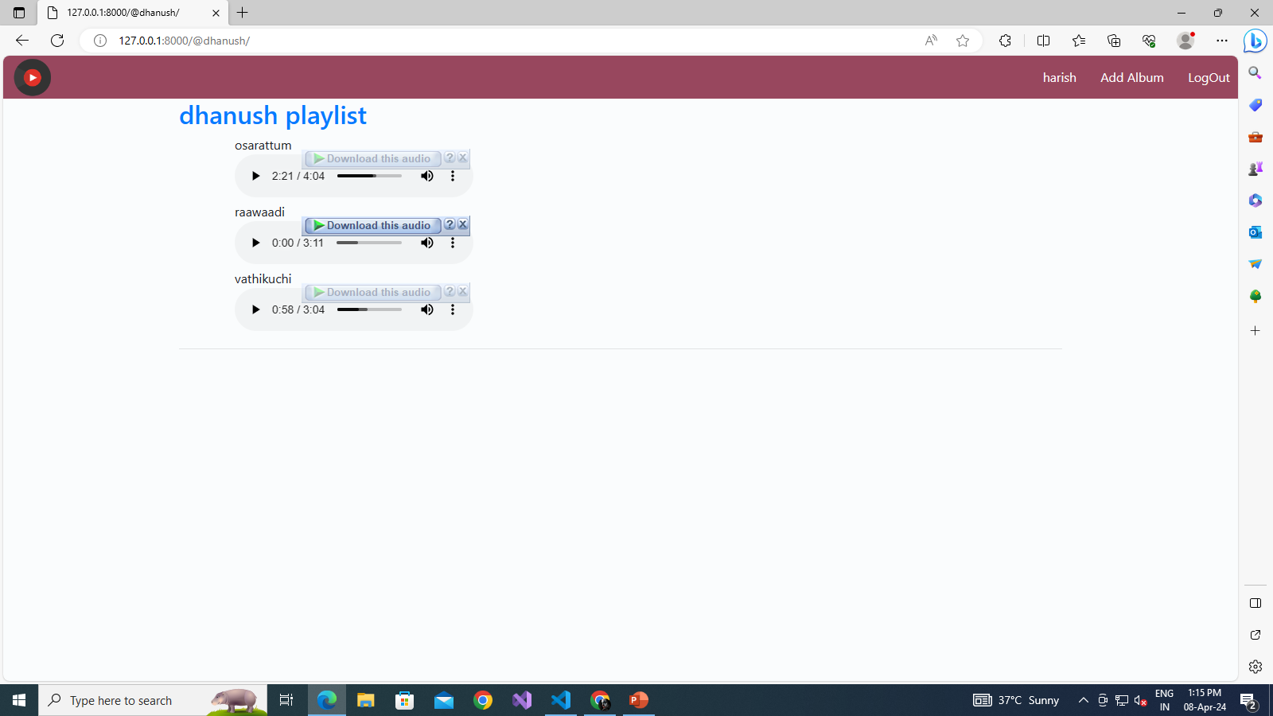

Slide 10
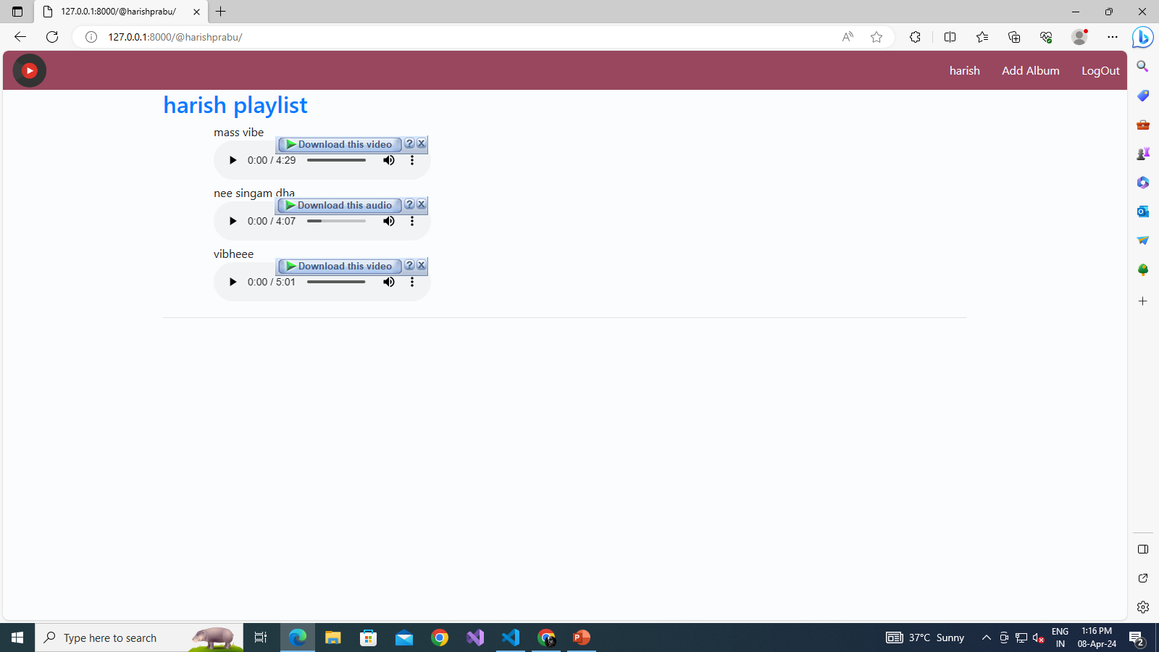

Slide 12
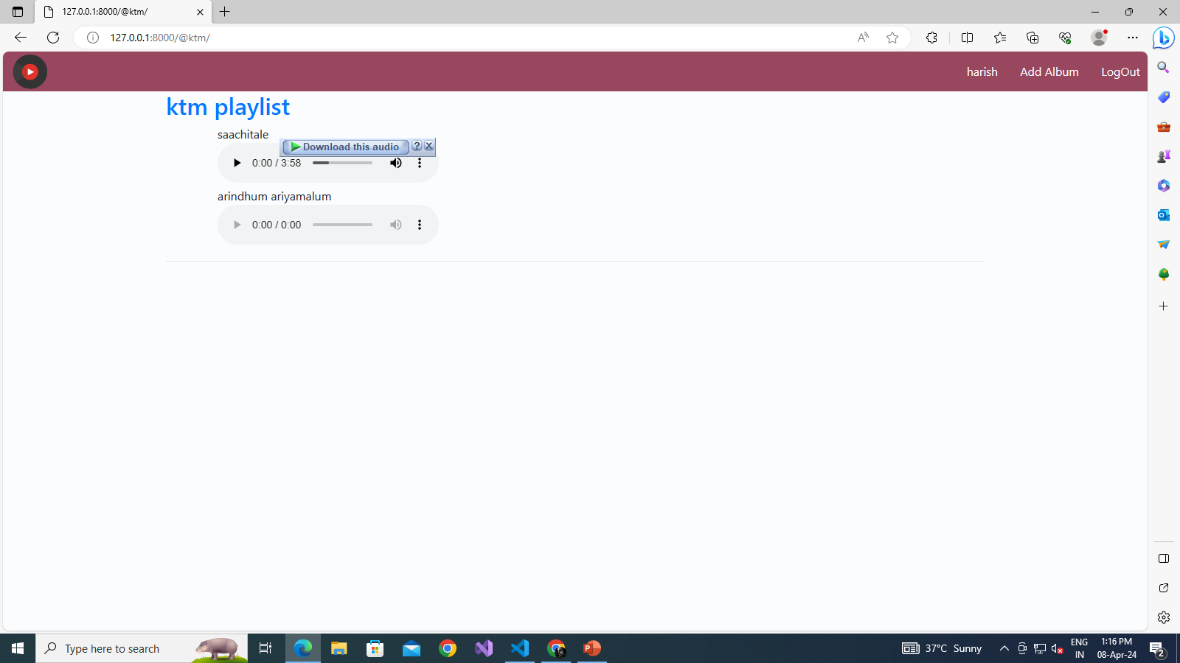

Slide 13
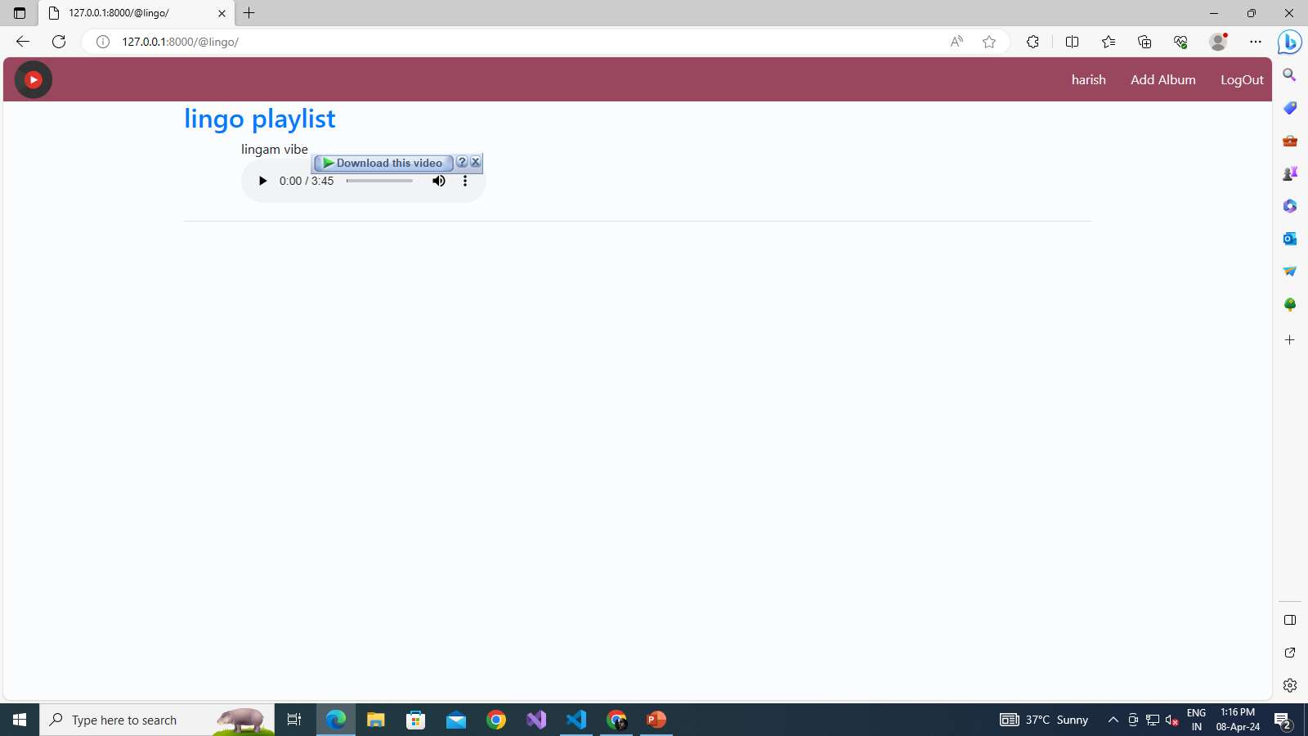

Slide 14
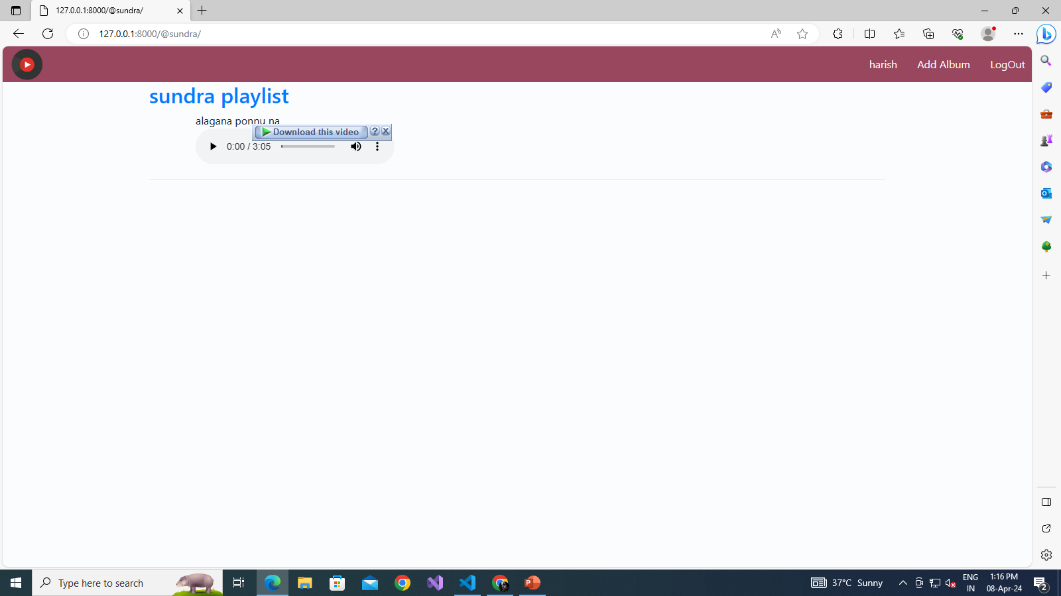

Slide 15


Slide 16
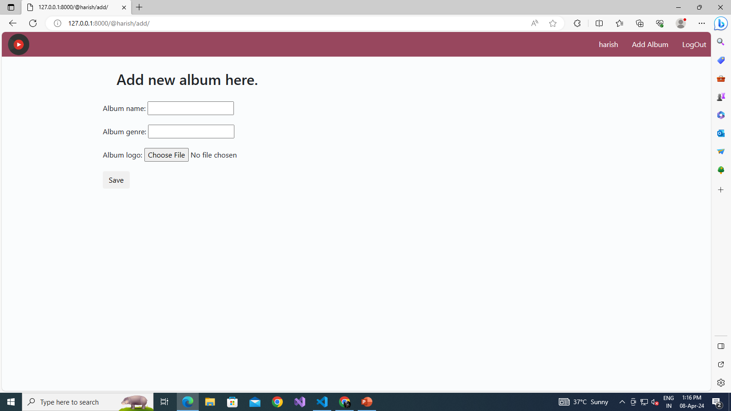

Slide 17
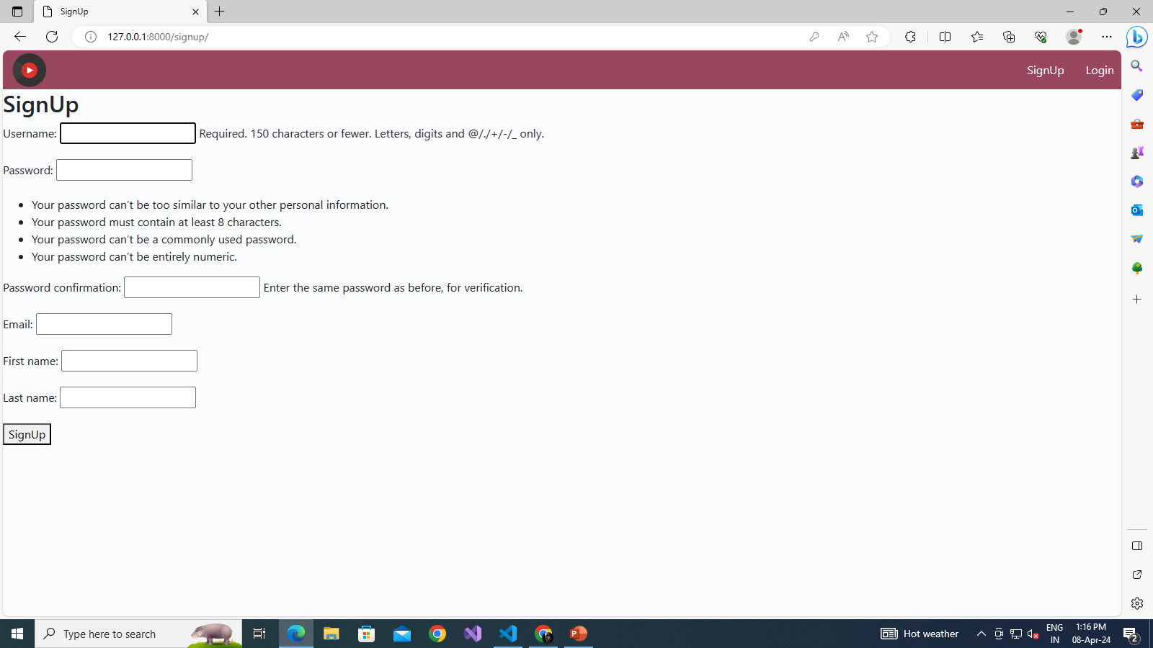

Slide 18
